Slide 1

REAL-TIME CRYPTOCURRENCY STREAMING & VISUALIZATION
STUDENT NAME:VIDYA-SANDEEP NAKADE
PROGRAMME: MSC COMPUTER SCIENCE AND DATA SCIENCE
COURCE: BIG DATA & DISTRIBUTED PROCESS
ACADEMIC YEAR: 2025–2026
GUIDED BY: ZHANG YIRU & LI YUE

Slide 2
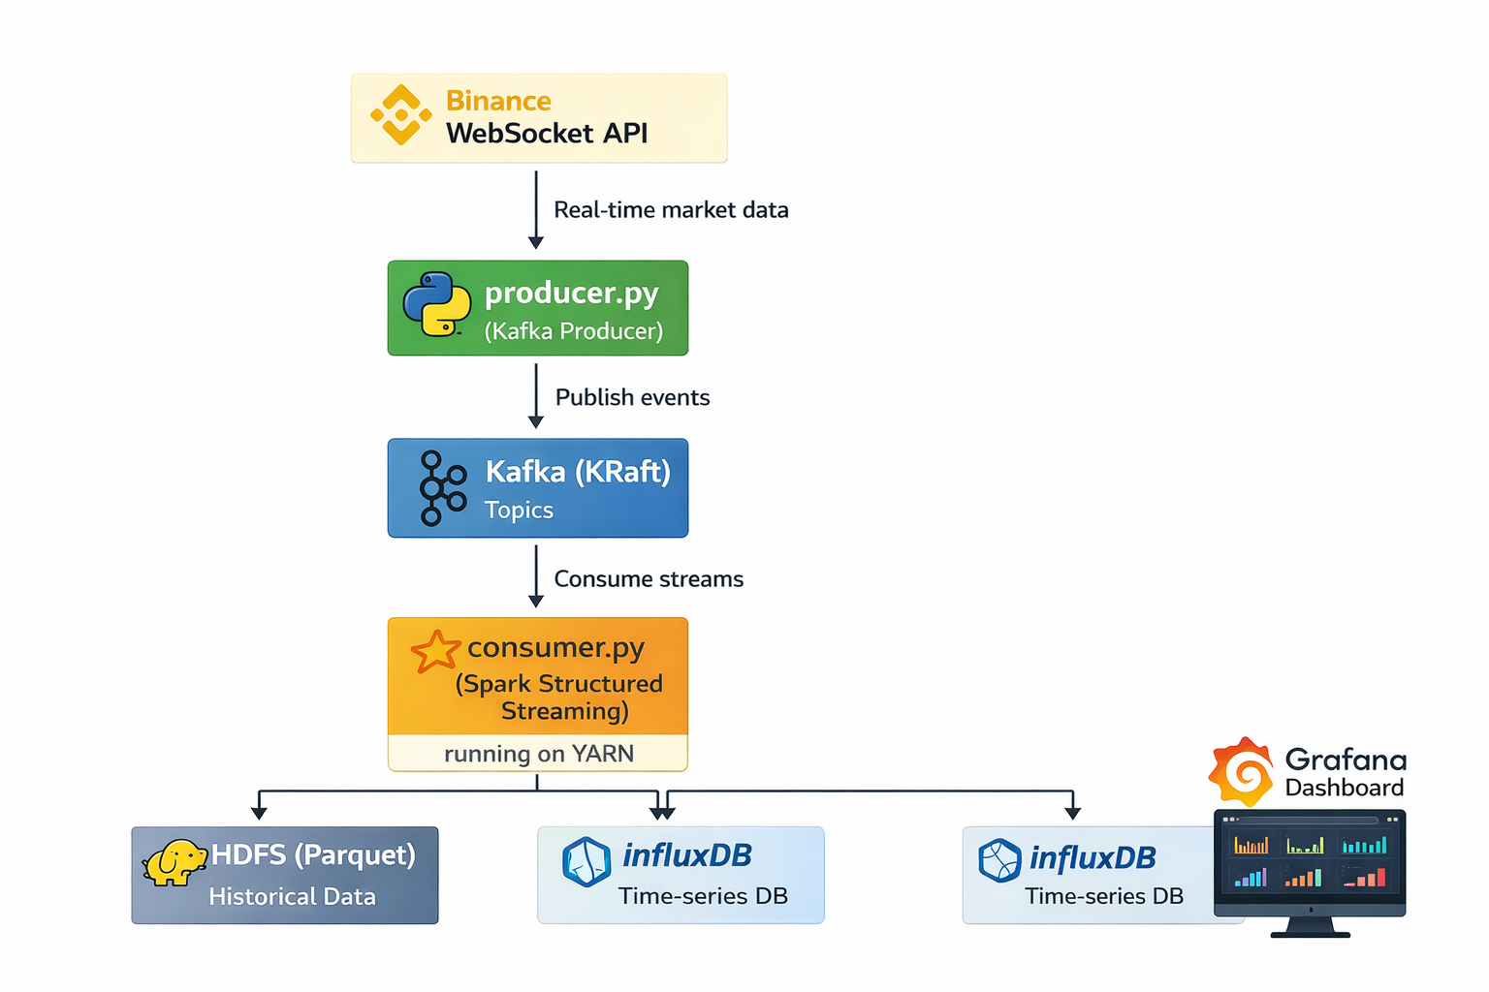
ARCHITECTURE DIAGRAM

Slide 3

CONCLUSION
Project Summary:
Successfully deployed a Real-Time Big Data Pipeline on a multi-node cluster.
Integrated Kafka, Spark, and HDFS for high-throughput, fault-tolerant processing.
Achieved sub-second visualization latency using InfluxDB & Grafana.
Future Enhancements:
Implementation of Machine Learning models (Spark MLlib) for price prediction.
Scaling the cluster with additional Worker Nodes for higher data volume.
Adding multi-currency support simultaneously.

Slide 4

THANK YOU

